Slide 1
Automated Planning and Acting
Refinement Methods
Tanya Braun
Research Group Data Science, Computer Science Department

Slide 2
Content: Planning and Acting
With Deterministic Models
With Refinement Methods
  Operational Models
  Refinement-Acting Machine
  Refinement Planning
  Acting and Refinement Planning
With Temporal Models
With Nondeterministic Models
With Probabilistic Models
By Decision Making
  Foundations
  Extensions
  Structure
With human-awareness
Notes:
1-4, 6: Planning book
5, 7: AIMA
8: Rao

Slide 3
Motivation & Assumptions
respond to user requests
Hierarchically organised deliberation
  At high levels, abstract actions
  At lower levels, more detail
Refine abstract actions into ways of carrying them out
  How?
Remove / weaken assumptions from classical planning
  Characteristics
    Dynamic environment
    Imperfect information
    Overlapping actions
    Nondeterminism
    Hierarchy
    Discrete and continuous variables
…
bring o7 to loc2
…
go to
hallway
navigate
to loc1
fetch
o7
navigate
to loc2
deliver
o7
Planning Acting
…
…
…
…
move to door
open door
get out
close door
…
…
…
identify
type
of
door
move
close
to
knob
grasp
knob
turn
knob
maintain
move
back
ungrasp
pull
monitor
pull
monitor

Slide 4




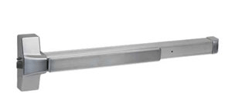

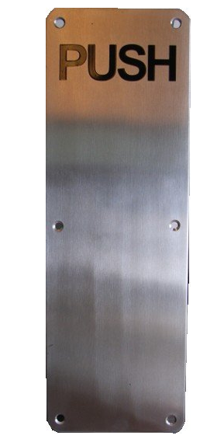


Opening a Door
move to door
open door
get out
close door
…
…
…
Many different methods, depending on what kind
of door
  Sliding or hinged?
  Hinge on left or right?
  Open toward or away?
  Knob, lever, push bar
  Pull handle, push plate
  Something else?
identify
type
of
door
move
close
to
knob
grasp
knob
turn
knob
maintain
move
back
ungrasp
pull
monitor
pull
monitor

Slide 5
Outline per the Book
3.1 Representation
  State variables, commands, refinement methods
  Example
3.2 Acting
  RAE (Refinement Acting Engine)
  Example
  Extensions
3.3 Planning
  Motivation and basic ideas
  Deterministic action models
  SeRPE (Sequential Refinement Planning Engine)
3.4 Using Planning in Acting
  Techniques
  Caveats

Slide 6
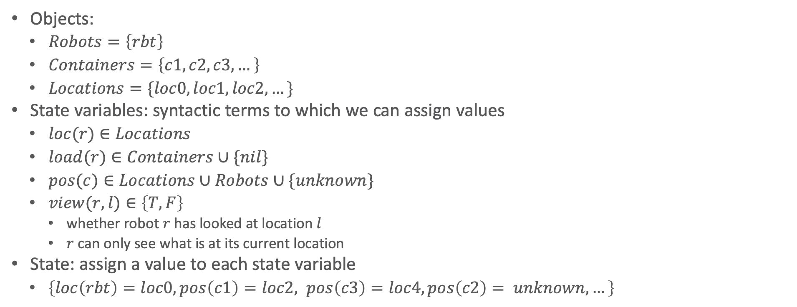
State-variable Representation (Recap)
Objects:
  $Robots=\left\{rbt\right\}$
  $Containers=\left\{c1, c2, c3, …\right\}$
  $Locations=\{loc0, loc1, loc2, …\}$
State variables: syntactic terms to which we can assign values
  $loc(r)∈Locations$
  $load(r)∈Containers∪\{nil\}$
  $pos(c)∈Locations∪Robots∪\{unknown\}$
  $view(r,l)∈\left\{T, F\right\}$
    whether robot $r$ has looked at location $l$
    $r$ can only see what is at its current location
State: assign a value to each state variable
  $\left\{loc\left(rbt\right)=loc0, pos\left(c1\right)=loc2, pos\left(c3\right)=loc4, pos\left(c2\right)= unknown, …\right\}$
c3
loc4
loc3
c1
loc2
loc1
rbt
loc0

Slide 7
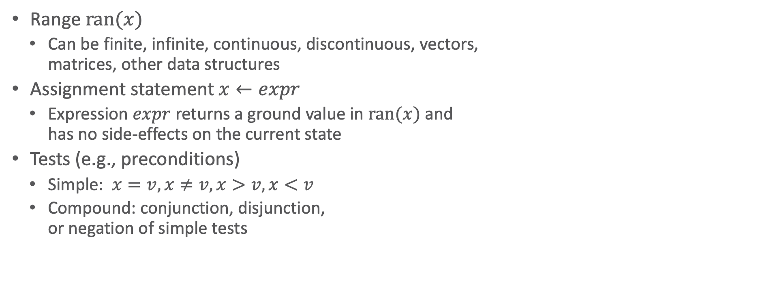
State-variable Representation: Extensions
Range $ran(x)$
  Can be finite, infinite, continuous, discontinuous, vectors,
  matrices, other data structures
Assignment statement $x←expr$
  Expression $expr$ returns a ground value in $ran(x)$ and
  has no side-effects on the current state
Tests (e.g., preconditions)
  Simple: $x=v, x≠v, x>v, x<v$
  Compound: conjunction, disjunction,
  or negation of simple tests
c3
loc4
loc3
c1
loc2
loc1
rbt
loc0

Slide 8
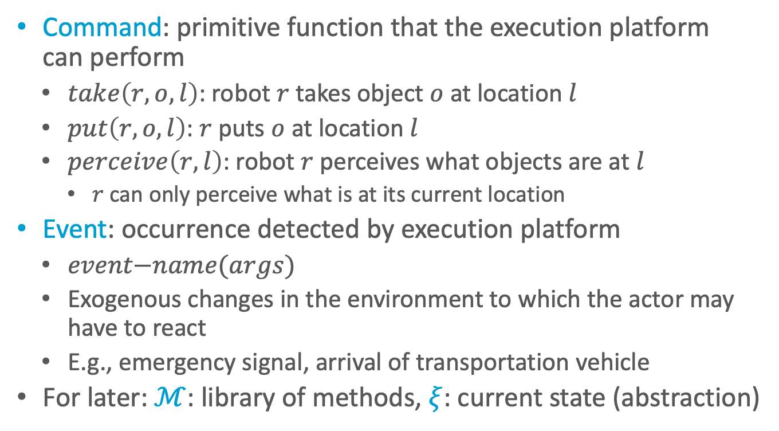


Commands
Command: primitive function that the execution platform
can perform
  $take\left(r,o,l\right)$: robot $r$ takes object $o$ at location $l$
  $put\left(r,o,l\right)$: $r$ puts $o$ at location $l$
  $perceive\left(r,l\right)$: robot $r$ perceives what objects are at $l$
    $r$ can only perceive what is at its current location
Event: occurrence detected by execution platform
  $event\text{−}name(args)$
  Exogenous changes in the environment to which the actor may have to react
  E.g., emergency signal, arrival of transportation vehicle
For later: $ℳ$: library of methods, $ξ$: current state (abstraction)
Actor
tasks
$$ℳ$$
Acting
$$ξ$$
commands
events
Execution platform
Actuations
Signals
External world

Slide 9
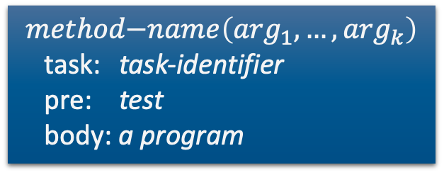
Tasks and Methods
Task: an activity for the actor to perform
  Could be an abstract action of a plan
For each task, a set of refinement methods
  Operational models:
    Tell how to perform the task
    Do not predict what it will do
Actor
tasks
$$ℳ$$
Acting
$$ξ$$
commands
events
$$method\text{−}name\left(\arg_{1}, …, \arg_{k}\right)$$
task: task-identifier
pre: test
body: a program
Execution platform
assignment statements
control constructs: if-then-else, while, …
tasks (can extend to include events, goals)
commands to the execution platform

Slide 10
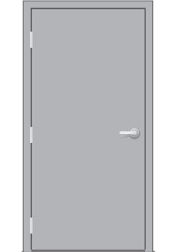
Example: “open door” task
move to door
open door
get out
close door
…
…
…
identify
type
of
door
move
close
to
knob
grasp
knob
turn
knob
maintain
move
back
ungrasp
pull
What kind:
  Hinged on left
  Opens toward us
  Lever handle
Refinement method
monitor
pull
monitor
m1-unlatch(r,d,l,o)
task: unlatch(r,d)
pre: loc(r,l)∧toward-side(l,d)∧
side(d,left)∧type(d,rotate)∧handle(d,o)
body: grasp(r,o)
turn(r,o,alpha1)
pull(r,val1)
if door-status(d)=cracked then ungrasp(r,o)
else fail
m-opendoor(r,d,l,h)
task: opendoor(r,d)
pre: loc(r) = l ∧ adj(l,d)
∧ handle(d,h)
body:
while ¬reachable(r,h) do
move-close(r,h)
monitor-status(r,d)
if door-status(d)=closed then
unlatch(r,d)
throw-wide(r,d)
end-monitor-status(r,d)
m1-throw-wide(r,d,l,o)
task: throw-wide(r,d)
pre: loc(r,l)∧toward-side(l,d)∧
side(d,left) ∧ type(d,rotate) ∧
handle(d,o) ∧ door-status(d)=cracked
body: grasp(r,o)
pull(r,val1)
move-by(r,val2)

Slide 11
Intermediate Summary
3.1 Operational models
  Tasks, events
  Commands to the execution platform
  Extensions to state-variable representation
  Refinement method: name, task/event, preconditions, body
  Example: opening a door

Slide 12
Outline per the Book
3.1 Representation
  State variables, commands, refinement methods
  Example
3.2 Acting
  RAE (Refinement Acting Engine)
  Example
  Extensions
3.3 Planning
  Motivation and basic ideas
  Deterministic action models
  SeRPE (Sequential Refinement Planning Engine)
3.4 Using Planning in Acting
  Techniques
  Caveats

Slide 13
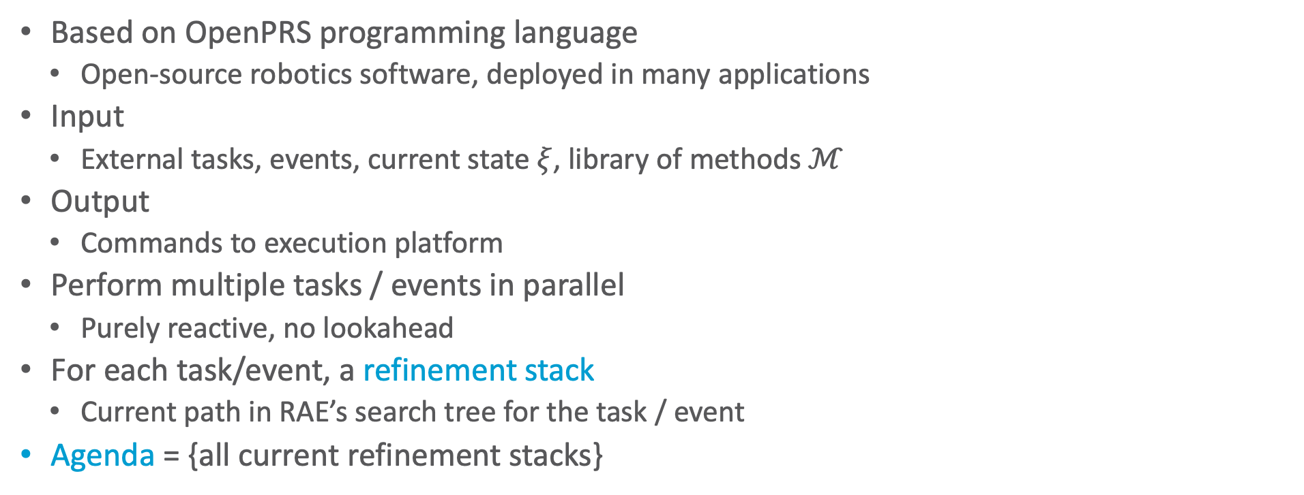
RAE (Refinement Acting Engine)
Based on OpenPRS programming language
  Open-source robotics software, deployed in many applications
Input
  External tasks, events, current state $ξ$, library of methods $ℳ$
Output
  Commands to execution platform
Perform multiple tasks / events in parallel
  Purely reactive, no lookahead
For each task/event, a refinement stack
  Current path in RAE’s search tree for the task / event
Agenda = {all current refinement stacks}
Actor
tasks
$$ℳ$$
Acting
$$ξ$$
commands
events
Execution platform
Actuations
Signals
External world
Notes:
Acting with an operational model as given in first section
E.g., act out next tasks of several Run-Lookahead instances

Slide 14
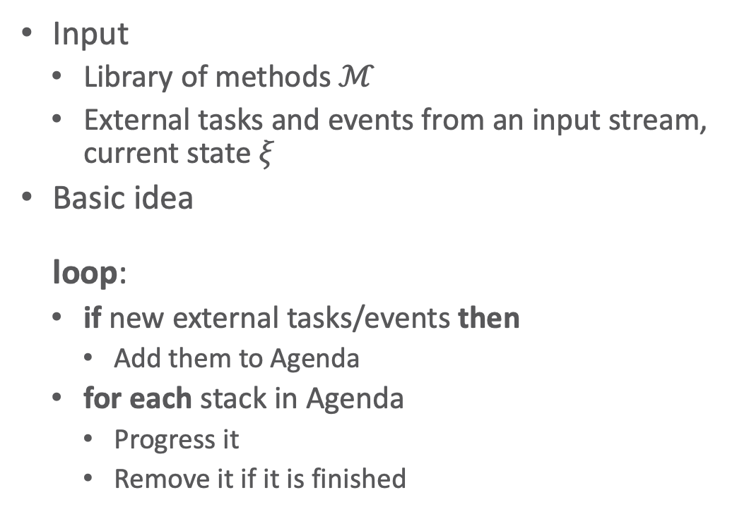
RAE (Refinement Acting Engine)
RAE(ℳ)
Agenda ← ∅
loop
until the input of external tasks and
events is empty do
read 𝜏 in the input stream
Candidates ← Instances(ℳ,𝜏,𝜉)
if Candidates = ∅ then
output(“failed to address” 𝜏)
else do
arbitrarily choose m ∈ Candidates
Agenda ← Agenda ∪ {⟨(𝜏,m,nil,∅)⟩}
for each stack ∈ Agenda do
Progress(stack)
if stack = ∅ then
Agenda ← Agenda \ {stack}
Input
  Library of methods $ℳ$
  External tasks and events from an input stream, current state $ξ$
Basic idea
loop:
  if new external tasks/events then
    Add them to Agenda
  for each stack in Agenda
    Progress it
    Remove it if it is finished
Stack element(𝜏,m,i,tried)
  𝜏 task
  m instance of a method in ℳ
  i instruction pointer to
  step in body of m
  tried method instances already tried
Notes:
Instances() = set of instances of methods in M whose pre-conditions hold in ξ and whose role matches the task or event τ.

Slide 15
Progress (subroutine)
Progress(stack)
(𝜏,m,i,tried) ← top(stack)
if i ≠ nil and m[i] is a command then
case status(m[i])
running: return
failure: Retry(stack); return
done: continue
if i is the last step of m then
pop(stack)
else do
i ← nextstep(m,i)
case type(m[i])
assignment: update 𝜉 according
to m[i]; return
command: trigger m[i]; return
task or goal: continue
𝜏’ ← m[i]
Candidates ← Instances(ℳ,𝜏’,𝜉)
if Candidates = ∅ then
Retry(stack)
else do
arbitrarily choose m’ ∈ Candidates
push((𝜏’,m’,nil,∅),stack)
Just a decision tree
Notes:
Retry

Slide 16
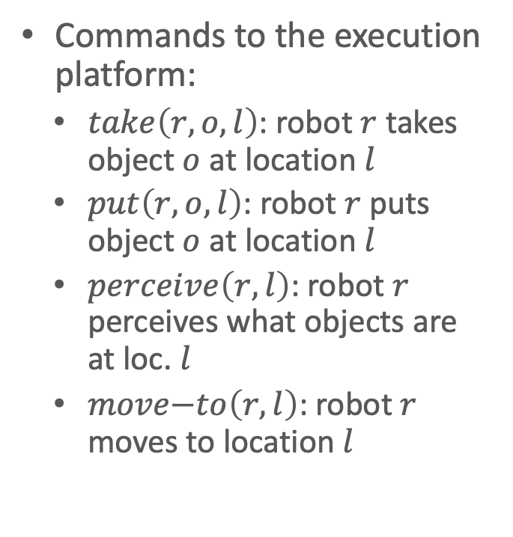
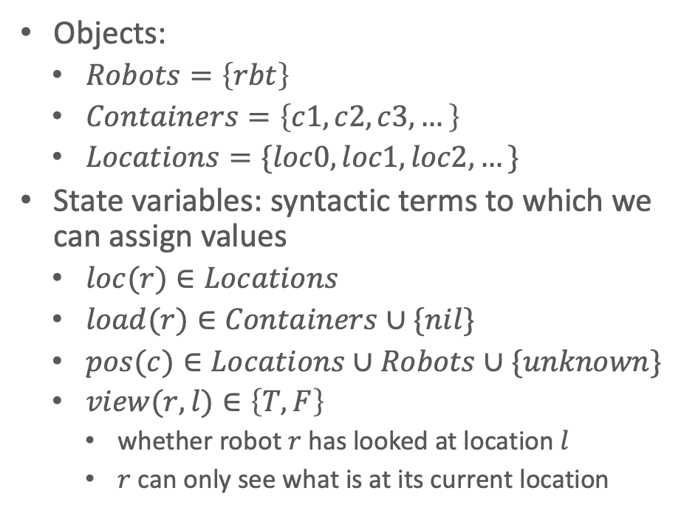
Example
Objects:
  $Robots=\left\{rbt\right\}$
  $Containers=\left\{c1, c2, c3, …\right\}$
  $Locations=\{loc0, loc1, loc2, …\}$
State variables: syntactic terms to which we can assign values
  $loc(r)∈Locations$
  $load(r)∈Containers∪\{nil\}$
  $pos(c)∈Locations∪Robots∪\{unknown\}$
  $view(r,l)∈\left\{T, F\right\}$
    whether robot $r$ has looked at location $l$
    $r$ can only see what is at its current location
Commands to the execution platform:
  $take\left(r,o,l\right)$: robot $r$ takes object $o$ at location $l$
  $put\left(r,o,l\right)$: robot $r$ puts object $o$ at location $l$
  $perceive\left(r,l\right)$: robot $r$ perceives what objects are at loc. $l$
  $move\text{−}to\left(r,l\right)$: robot $r$ moves to location $l$
c3
loc4
loc3
c1
loc2
loc1
rbt
loc0

Slide 17
Example
m-fetch(r,c)
task: fetch(r,c)
pre:
body:
if pos(c) = unknown then
search(r,c)
else if loc(r) = pos(c) then
take(r,c,pos(c))
else do
move-to(r,pos(c))
take(r,c,pos(c))
?
𝜏: fetch(r1,c2)
m: ?
i: (see method)
tried: ∅
m-search(r,c)
task: search(r,c)
pre: pos(c) = unknown
body:
if ∃l (view(r,l) = F) then
  move-to(r,l)
  perceive(l)
  if pos(c) = l then
  take(r,c,l)
  else search(r,c)
  else fail
Refinement stack

Slide 18
Example
m-fetch(r,c)
task: fetch(r,c)
pre:
body:
if pos(c) = unknown then
search(r,c)
else if loc(r) = pos(c) then
take(r,c,pos(c))
else do
move-to(r,pos(c))
take(r,c,pos(c))
𝜏: fetch(r1,c2)
m: m-fetch(r1,c2)
i: (see method)
tried: ∅
m-search(r,c)
task: search(r,c)
pre: pos(c) = unknown
body:
if ∃l (view(r,l) = F) then
  move-to(r,l)
  perceive(l)
  if pos(c) = l then
  take(r,c,l)
  else search(r,c)
  else fail
Refinement stack

Slide 19
Example
m-fetch(r,c)
task: fetch(r,c)
pre:
body:
if pos(c) = unknown then
search(r,c)
else if loc(r) = pos(c) then
take(r,c,pos(c))
else do
move-to(r,pos(c))
take(r,c,pos(c))
𝜏: search(r1,c2)
m: ?
i: (see method)
tried: ∅
𝜏: fetch(r1,c2)
m: m-fetch(r1,c2)
i: (see method)
tried: ∅
m-search(r,c)
task: search(r,c)
pre: pos(c) = unknown
body:
if ∃l (view(r,l) = F) then
  move-to(r,l)
  perceive(l)
  if pos(c) = l then
  take(r,c,l)
  else search(r,c)
  else fail
Refinement stack

Slide 20
Example
m-fetch(r,c)
task: fetch(r,c)
pre:
body:
if pos(c) = unknown then
search(r,c)
else if loc(r) = pos(c) then
take(r,c,pos(c))
else do
move-to(r,pos(c))
take(r,c,pos(c))
𝜏: search(r1,c2)
m: m-search(r1,c2)
i: (see method)
tried: ∅
𝜏: fetch(r1,c2)
m: m-fetch(r1,c2)
i: (see method)
tried: ∅
m-search(r,c)
task: search(r,c)
pre: pos(c) = unknown
body:
if ∃l (view(r,l) = F) then
  move-to(r,l)
  perceive(l)
  if pos(c) = l then
  take(r,c,l)
  else search(r,c)
  else fail
Refinement stack

Slide 21
Example
m-fetch(r,c)
task: fetch(r,c)
pre:
body:
if pos(c) = unknown then
search(r,c)
else if loc(r) = pos(c) then
take(r,c,pos(c))
else do
move-to(r,pos(c))
take(r,c,pos(c))
…
𝜏: search(r1,c2)
m: m-search(r1,c2)
i: (see method)
tried: ∅
𝜏: fetch(r1,c2)
m: m-fetch(r1,c2)
i: (see method)
tried: ∅
m-search(r,c)
task: search(r,c)
pre: pos(c) = unknown
body:
if ∃l (view(r,l) = F) then
  move-to(r,l)
  perceive(l)
  if pos(c) = l then
  take(r,c,l)
  else search(r,c)
  else fail
Refinement stack
…
…

Slide 22
Example
m-fetch(r,c)
task: fetch(r,c)
pre:
body:
if pos(c) = unknown then
search(r,c)
else if loc(r) = pos(c) then
take(r,c,pos(c))
else do
move-to(r,pos(c))
take(r,c,pos(c))
…
𝜏: search(r1,c2)
m: m-search(r1,c2)
i: (see method)
tried: ∅
𝜏: fetch(r1,c2)
m: m-fetch(r1,c2)
i: (see method)
tried: ∅
m-search(r,c)
task: search(r,c)
pre: pos(c) = unknown
body:
if ∃l (view(r,l) = F) then
  move-to(r,l)
  perceive(l)
  if pos(c) = l then
  take(r,c,l)
  else search(r,c)
  else fail
Refinement stack
…

Slide 23
Example
m-fetch(r,c)
task: fetch(r,c)
pre:
body:
if pos(c) = unknown then
search(r,c)
else if loc(r) = pos(c) then
take(r,c,pos(c))
else do
move-to(r,pos(c))
take(r,c,pos(c))
…
𝜏: search(r1,c2)
m: m-search(r1,c2)
i: (see method)
tried: ∅
𝜏: fetch(r1,c2)
m: m-fetch(r1,c2)
i: (see method)
tried: ∅
m-search(r,c)
task: search(r,c)
pre: pos(c) = unknown
body:
if ∃l (view(r,l) = F) then
  move-to(r,l)
  perceive(l)
  if pos(c) = l then
  take(r,c,l)
  else search(r,c)
  else fail
Refinement stack
…
sensor failure

Slide 24
Example
m-fetch(r,c)
task: fetch(r,c)
pre:
body:
if pos(c) = unknown then
search(r,c)
else if loc(r) = pos(c) then
take(r,c,pos(c))
else do
move-to(r,pos(c))
take(r,c,pos(c))
𝜏: search(r1,c2)
m: ?
i: (see method)
tried:{m-search(r1,c2)}
𝜏: fetch(r1,c2)
m: m-fetch(r1,c2)
i: (see method)
tried: ∅
m-search(r,c)
task: search(r,c)
pre: pos(c) = unknown
body:
if ∃l (view(r,l) = F) then
  move-to(r,l)
  perceive(l)
  if pos(c) = l then
  take(r,c,l)
  else search(r,c)
  else fail
?
Refinement stack
…
If other candidates for search(r1,c2), try them.

Slide 25
Retry (subroutine)
Retry(stack)
(𝜏,m,i,tried) ← pop(stack)
tried ← tried ∪ {m}
Candidates ← Instances(ℳ,𝜏,𝜉) \ tried
if Candidates ≠ ∅ then
arbitrarily choose m’ ∈ Candidates
push((𝜏,m’,nil,∅),stack)
else do
if stack ≠ ∅ then
Retry(stack)
else do
output(“failed to accomplish” 𝜏)
Agenda ← Agenda \ stack
Another decision tree

Slide 26
Example
m-fetch(r,c)
task: fetch(r,c)
pre:
body:
if pos(c) = unknown then
search(r,c)
else if loc(r) = pos(c) then
take(r,c,pos(c))
else do
move-to(r,pos(c))
take(r,c,pos(c))
𝜏: fetch(r1,c2)
m: m-fetch(r1,c2)
i: (see method)
tried: ∅
m-search(r,c)
task: search(r,c)
pre: pos(c) = unknown
body:
if ∃l (view(r,l) = F) then
  move-to(r,l)
  perceive(l)
  if pos(c) = l then
  take(r,c,l)
  else search(r,c)
  else fail
none
Refinement stack
…
sensor failure

Slide 27
Example
m-fetch(r,c)
task: fetch(r,c)
pre:
body:
if pos(c) = unknown then
search(r,c)
else if loc(r) = pos(c) then
take(r,c,pos(c))
else do
move-to(r,pos(c))
take(r,c,pos(c))
?
𝜏: fetch(r1,c2)
m: ?
i: (see method)
tried:{m-fetch(r1,c2)}
m-search(r,c)
task: search(r,c)
pre: pos(c) = unknown
body:
if ∃l (view(r,l) = F) then
  move-to(r,l)
  perceive(l)
  if pos(c) = l then
  take(r,c,l)
  else search(r,c)
  else fail
none
Refinement stack
sensor failure
If other candidates for fetch(r1,c2), try them.

Slide 28
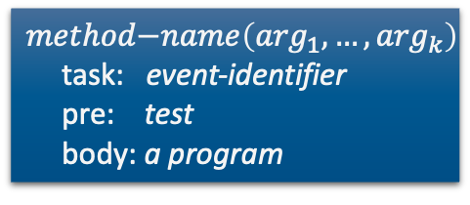

Extensions to RAE: Events
RAE(ℳ)
Agenda ← ∅
loop
until the input of external tasks and
events is empty do
read 𝜏 in the input stream
Candidates ← Instances(ℳ,𝜏,𝜉)
if Candidates = ∅ then
output(“failed to address” 𝜏)
else do
arbitrarily choose m ∈ Candidates
Agenda ← Agenda ∪ {⟨(𝜏,m,nil,∅)⟩}
for each stack ∈ Agenda do
Progress(stack)
if stack = ∅ then
Agenda ← Agenda \ {stack}
Example: an emergency
  If $r$ is not already handling another emergency, then
    Stop what it is doing
    Go handle the emergency
m-emergency(r,l,i)
event: emergency(l,i)
pre: emergency-handling(r) = F
body: emergency-handling(r) ← T
if load(r) ≠ nil then put(r,load(r))
move-to(l)
address-emergency(l,i)
$$method\text{−}name\left(\arg_{1}, …, \arg_{k}\right)$$
task: event-identifier
pre: test
body: a program

Slide 29
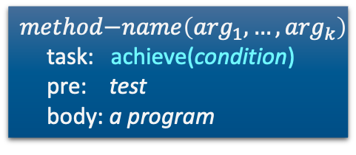
Extensions to RAE: Goals
RAE(ℳ)
Agenda ← ∅
loop
until the input of external tasks and
events is empty do
read 𝜏 in the input stream
Candidates ← Instances(ℳ,𝜏,𝜉)
if Candidates = ∅ then
output(“failed to address” 𝜏)
else do
arbitrarily choose m ∈ Candidates
Agenda ← Agenda ∪ {⟨(𝜏,m,nil,∅)⟩}
for each stack ∈ Agenda do
Progress(stack)
if stack = ∅ then
Agenda ← Agenda \ {stack}
Write as a special task
  Like others, but includes monitoring: modify Progress
    if condition becomes true before finishing body(m), stop early
    if condition isn’t true after finishing body(m), fail and try another method
m-fetch(r,c)
task: fetch(r,c)
pre:
body: if pos(c) = unknown then
search(r,c)
achieve(pos(c)≠unknown)
move-to(r,pos(c))
take(r,c,pos(c))
m-find-where(r,c)
task: achieve(pos(c)≠unknown)
pre:
body: while exists loc. l s.t. view(l) = F do
move-to(l)
perceive(l)
$$method\text{−}name\left(\arg_{1}, …, \arg_{k}\right)$$
task: achieve(condition)
pre: test
body: a program
Notes:
achieve as a task + method to handle task

Slide 30
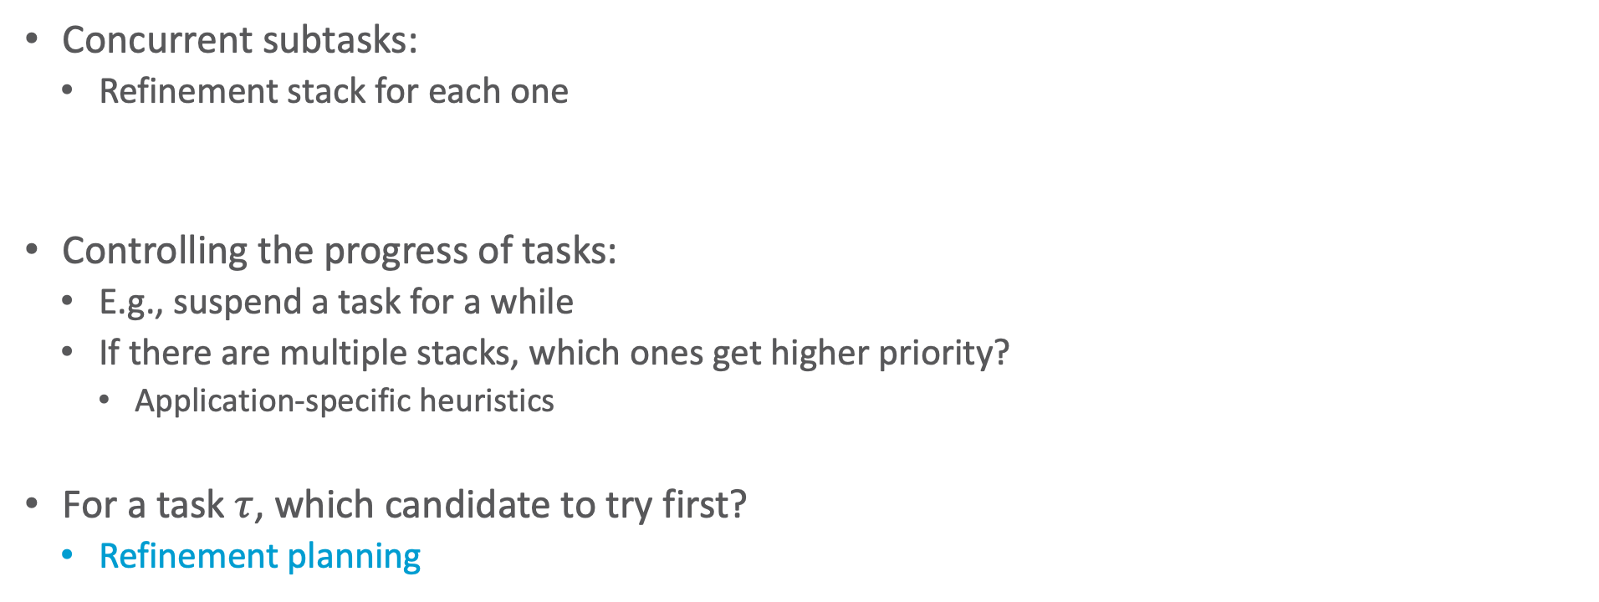
Other Extensions to RAE
Concurrent subtasks:
  Refinement stack for each one
Controlling the progress of tasks:
  E.g., suspend a task for a while
  If there are multiple stacks, which ones get higher priority?
    Application-specific heuristics
For a task $τ$, which candidate to try first?
  Refinement planning
body of a method
...
{concurrent: 𝜏₁, 𝜏₂, ..., 𝜏_{n}}
...
Agenda = {stack₁, stack₂, ..., stack_{n}}
Candidates ← Instances(ℳ, 𝜏, 𝜉)

Slide 31
Intermediate Summary
3.2 Refinement Acting Engine (RAE)
  Purely reactive: select a method and apply it
  RAE: input stream, Candidates, Instances, Agenda, refinement stacks
  Progress: command status, nextstep, type of step
  Retry: Candidates \ tried, Agenda \ stack
  Refinement trees
  Concurrent tasks: for each, a refinement stack
  Goal: achieve(condition), uses monitoring
  Controlling progress, heuristics

Slide 32
Outline per the Book
3.1 Representation
  State variables, commands, refinement methods
  Example
3.2 Acting
  RAE (Refinement Acting Engine)
  Example
  Extensions
3.3 Planning
  Motivation and basic ideas
  Deterministic action models
  SeRPE (Sequential Refinement Planning Engine)
3.4 Using Planning in Acting
  Techniques
  Caveats

Slide 33
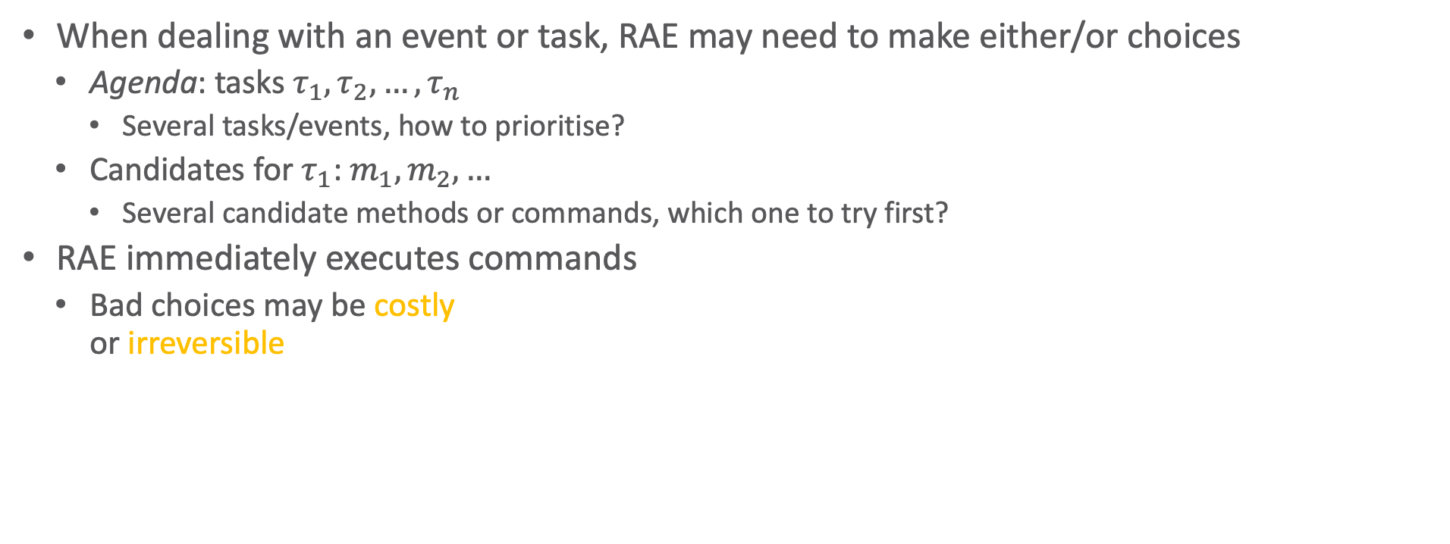
Motivation
When dealing with an event or task, RAE may need to make either/or choices
  Agenda: tasks $τ_{1}, τ_{2}, …, τ_{n}$
    Several tasks/events, how to prioritise?
  Candidates for $τ_{1}$: $m_{1}, m_{2}, …$
    Several candidate methods or commands, which one to try first?
RAE immediately executes commands
  Bad choices may be costly
  or irreversible

Slide 34
Refinement Planning
Basic idea:
  Go step by step through RAE, but do not send commands to execution platform
  For each command, use a descriptive action model to predict the next state
    Tells what, not how
  Whenever we need to choose a method
    Try various possible choices, explore consequences, choose best
Generalisation of Hierarchical Task Network (HTN) planning
  HTN planning: body of a method is a list of tasks
  Here: body of method is the same program RAE uses
  Use it to generate a list of tasks
Notes:
HTN ➝ seminar topic

Slide 35
Refinement Planning: Example
Suppose we learn in advance that the sensor is not available
  Planner infers that m-search(r1,c2) will fail
  If another method is available, use it
  Otherwise, planner will infer that the actor cannot do search(r1,c2)
Search tree:
Actor
tasks
$$ℳ$$
Acting
$$ξ$$
commands
events
Execution platform
Actuations
Signals
…
External world
sensor failure

Slide 36
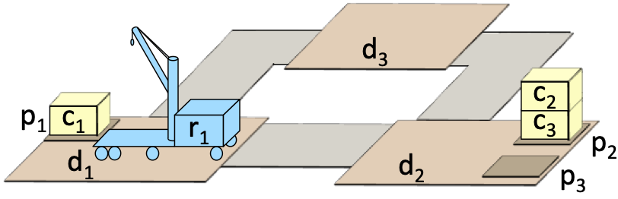
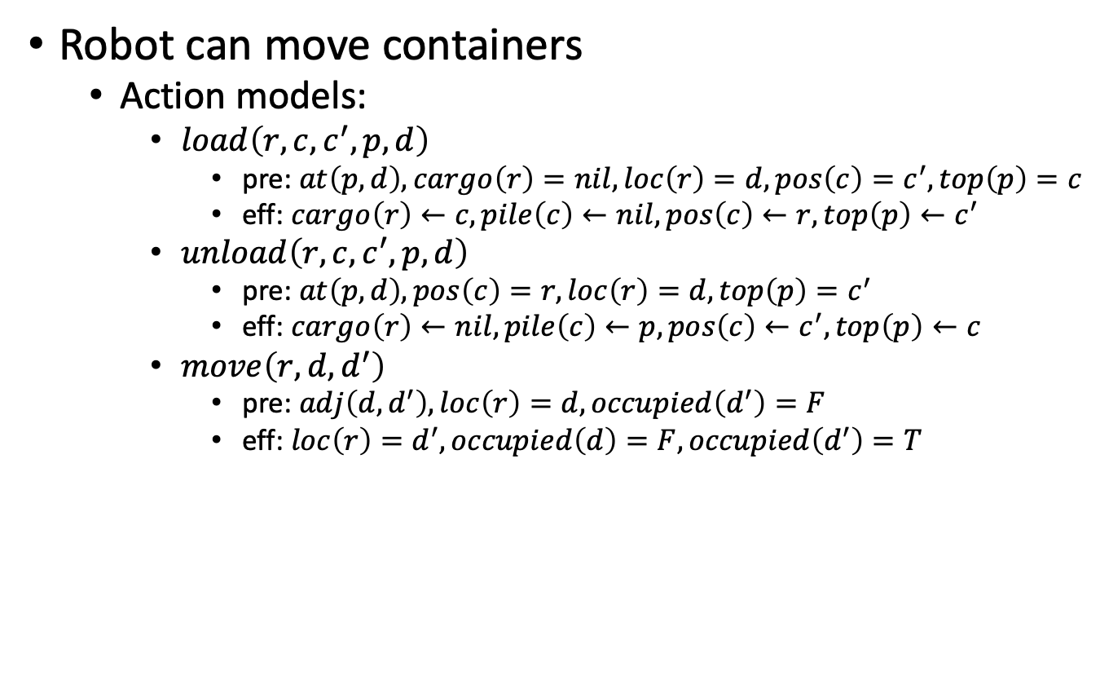
Simple Deterministic Domain
Robot can move containers
  Action models:
    $load\left(r,c,c^{′},p,d\right)$
      pre: $at\left(p,d\right), cargo\left(r\right)=nil, loc\left(r\right)=d, pos\left(c\right)=c^{′}, top\left(p\right)=c$
      eff: $cargo\left(r\right)←c, pile\left(c\right)←nil, pos\left(c\right)←r, top\left(p\right)←c^{′}$
    $unload\left(r,c,c^{′},p,d\right)$
      pre: $at\left(p,d\right), pos\left(c\right)=r, loc\left(r\right)=d, top\left(p\right)=c^{′}$
      eff: $cargo\left(r\right)←nil, pile\left(c\right)←p, pos\left(c\right)←c^{′}, top\left(p\right)←c$
    $move\left(r,d,d^{′}\right)$
      pre: $adj\left(d,d^{′}\right), loc\left(r\right)=d, occupied\left(d^{′}\right)=F$
      eff: $loc\left(r\right)=d^{′}, occupied\left(d\right)=F, occupied\left(d^{′}\right)=T$

Slide 37

Tasks and Methods
Task: put-in-pile(c,p′) –
put $c$ into pile $p^{′}$ if not there
  If $c$ is not in $p^{′}$:
    Find a route to $c$, follow it to $c$
    Uncover $c$, load $c$ onto $r$
    Move to $p^{′}$, unload $c$
  If $c$ is already in $p^{′}$, do nothing
  m1-put-in-pile(c,p′)
    task: put-in-pile(c,p′)
    pre: pile(c)=p′
    body: // empty
m2-put-in-pile(r,c,p,d,p′,d′)
task: put-in-pile(c,p′)
pre: pile(c)=p ∧ at(p,d) ∧ at(p′,d′)
∧ p ≠ p′ ∧ cargo(r)=nil
body: if loc(r) ≠ d then navigate(r,d)
uncover(c)
load(r, c, pos(c), p, d)
if loc(r) ≠ d′ then navigate(r,d′)
unload(r, c, top(p′), p′, d)

Slide 38
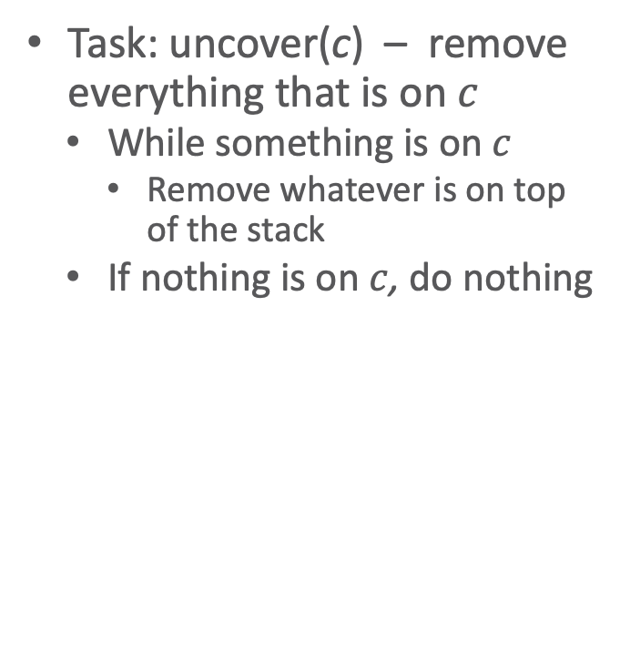
Tasks and Methods
Task: uncover(c) – remove everything that is on $c$
  While something is on $c$
    Remove whatever is on top of the stack
  If nothing is on $c$, do nothing
  m1-uncover(c)
    task: uncover(c)
    pre: top(pile(c))=c
    body: // empty
m2-uncover(r,c,c,p′,d)
  task: uncover(c)
  pre: pile(c)=p ∧ top(p)≠c
  ∧ at(p,d) ∧ at(p′,d) ∧ p′ ≠ p
  ∧ loc(r)=d ∧ cargo(r)=nil
  body: while top(p) ≠ c do
  c′ ← top(p)
  load(r,c′,pos(c′),p,d)
  unload(r,c′,top(p′),p′,d)
c3
c2
c2
c2
c1
c1
c3
c1
c3

Slide 39

SeRPE (Sequential Refinement
Planning Engine)
SeRPE(ℳ,𝒜,s,𝜏)
Candidates ← Instances(ℳ,𝜏,s)
if Candidates = ∅ then
return failure
nondeterministically choose m ∈ Candidates
return Progress-to-finish(ℳ,𝒜,s,𝜏,m)
SeRPE inputs
Which candidate method for $τ$?
  SeRPE: Nondeterministic choice
    Backtracking point
    How to implement?
      Hierarchical adaptation of backtracking, A*, GBFS, ...
  RAE: Arbitrary choice
    No search, purely reactive
M = {methods}
A = {action models}
s = initial state
𝜏 = task or goal
RAE(ℳ)
Agenda ← ∅
loop
until the input of external tasks and
events is empty do
read 𝜏 in the input stream
Candidates ← Instances(ℳ,𝜏,𝜉)
if Candidates = ∅ then
output(“failed to address” 𝜏)
else do
arbitrarily choose m ∈ Candidates
Agenda ← Agenda ∪ {⟨(𝜏,m,nil,∅)⟩}
for each stack ∈ Agenda do
Progress(stack)
if stack = ∅ then
Agenda ← Agenda \ {stack}

Slide 40
SeRPE (Sequential Refinement
Planning Engine)
SeRPE(ℳ,𝒜,s,𝜏)
Candidates ← Instances(ℳ,𝜏,s)
if Candidates = ∅ then
return failure
nondeterministically choose m ∈ Candidates
return Progress-to-finish(ℳ,𝒜,s,𝜏,m)
SeRPE
  One external task
  Simulate progressing it all the way to the end
RAE
  Several external tasks
  Each time through loop,
  progress each one by one step
RAE(ℳ)
Agenda ← ∅
loop
until the input of external tasks and
events is empty do
read 𝜏 in the input stream
Candidates ← Instances(ℳ,𝜏,𝜉)
if Candidates = ∅ then
output(“failed to address” 𝜏)
else do
arbitrarily choose m ∈ Candidates
Agenda ← Agenda ∪ {⟨(𝜏,m,nil,∅)⟩}
for each stack ∈ Agenda do
Progress(stack)
if stack = ∅ then
Agenda ← Agenda \ {stack}

Slide 41
Progress-to-finish
Progress-to-finish(ℳ,𝒜,s,𝜏,m)
i ← nil; 𝜋 ← ⟨⟩
loop
if 𝜏 is a goal and s ⊨ 𝜏 then
return 𝜋
if i is the last step of m then
if 𝜏 is a goal and s ⊭ 𝜏 then
return failure
return 𝜋
i ← nextstep(m,i)
case type(m[i])
assignment:
update s according to m[i]
command:
a ← descriptive model of m[i] in 𝒜
if s ⊨ pre(a) then
s ← 𝛾(s,a); 𝜋 ← 𝜋.a
else
return failure
task or goal:
𝜋’ ← SeRPE(ℳ,𝒜,s,m[i])
if 𝜋’ = failure then
return failure
s ← 𝛾(s,𝜋’); 𝜋 ← 𝜋. 𝜋’
Like RAE progress with a loop around it
  Simulates the commands

Slide 42
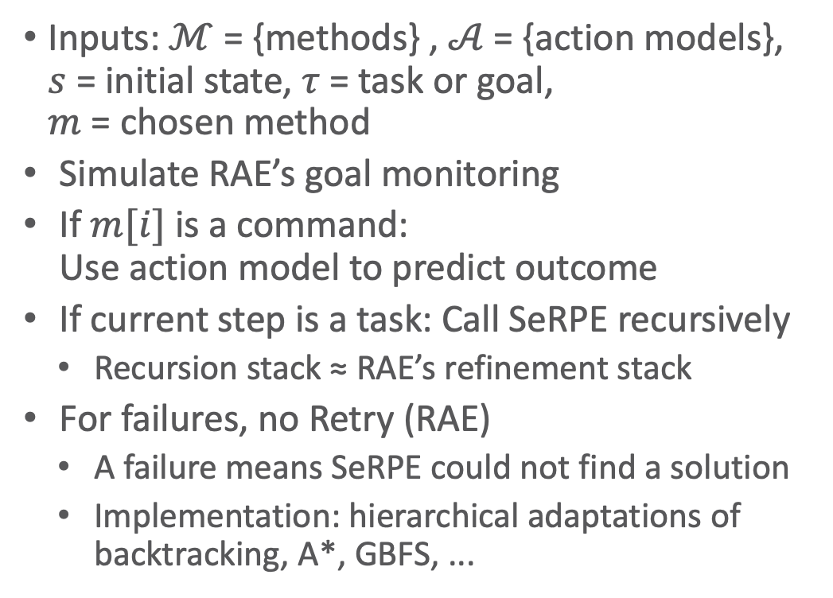
Progress-to-finish
Progress-to-finish(ℳ,𝒜,s,𝜏,m)
i ← nil; 𝜋 ← ⟨⟩
loop
if 𝜏 is a goal and s ⊨ 𝜏 then
return 𝜋
if i is the last step of m then
if 𝜏 is a goal and s ⊭ 𝜏 then
return failure
return 𝜋
i ← nextstep(m,i)
case type(m[i])
assignment:
update s according to m[i]
command:
a ← descriptive model of m[i] in 𝒜
if s ⊨ pre(a) then
s ← 𝛾(s,a); 𝜋 ← 𝜋.a
else
return failure
task or goal:
𝜋’ ← SeRPE(ℳ,𝒜,s,m[i])
if 𝜋’ = failure then
return failure
s ← 𝛾(s,𝜋’); 𝜋 ← 𝜋. 𝜋’
Inputs: $ℳ$ = {methods} , $𝒜$ = {action models},
$s$ = initial state, $τ$ = task or goal,
$m$ = chosen method
Simulate RAE’s goal monitoring
If $m[i]$ is a command:
Use action model to predict outcome
If current step is a task: Call SeRPE recursively
  Recursion stack ≈ RAE’s refinement stack
For failures, no Retry (RAE)
  A failure means SeRPE could not find a solution
  Implementation: hierarchical adaptations of backtracking, A*, GBFS, ...

Slide 43
Example
  Candidates = {m1-put-in-pile(c₁,p₂),
  m2-put-in-pile(r,c₁,p₁,d,p′,d′)}
SeRPE(ℳ,𝒜,s,𝜏)
Candidates ← Instances(ℳ,𝜏,s)
if Candidates = ∅ then
return failure
nondeterministically choose m ∈ Candidates
return Progress-to-finish(ℳ,𝒜,s,𝜏,m)
  m1-put-in-pile(c, p′)
    task: put-in-pile(c, p′)
    pre: pile(c)=p′
    body: // empty
s₀ = {loc(r₁)=d₁, cargo(r₁)=nil, occupied(d₁)=T,
occupied(d₂)=F, occupied(d₃)=F,
pos(c₁)=nil, pos(c₂)=c₃, pos(c₃)=nil,
pile(c₁)=p₁, pile(c₂)=p₂, pile(c₃)=p₂,
top(p₁)=c₁, top(p₂)=c₂, top(p₃)=nil}
m2-put-in-pile(r, c, p, d, p′, d′)
task: put-in-pile(c, p′)
pre: pile(c)=p ∧ at(p, d) ∧ at(p′, d′)
∧ p ≠ p′ ∧ cargo(r)=nil
body: if loc(r) ≠ d then navigate(r, d)
uncover(c)
load(r, c, pos(c), p, d)
if loc(r) ≠ d′ then navigate(r, d′)
unload(r, c, top(p′), p′, d)

Slide 44
Example
SeRPE(ℳ,𝒜,s,𝜏)
Candidates ← Instances(ℳ,𝜏,s)
if Candidates = ∅ then
return failure
nondeterministically choose m ∈ Candidates
return Progress-to-finish(ℳ,𝒜,s,𝜏,m)
Refinement tree
The SeRPE pseudocode
does not return this, but can easily be modified to do so
r₁,c₁,p₁,d₁,p₂,d₂
m2-put-in-pile(r, c, p, d, p′, d′)
task: put-in-pile(c, p′)
pre: pile(c)=p ∧ at(p, d) ∧ at(p′, d′)
∧ p ≠ p′ ∧ cargo(r)=nil
body: if loc(r) ≠ d then navigate(r, d)
uncover(c)
load(r, c, pos(c), p, d)
if loc(r) ≠ d′ then navigate(r, d′)
unload(r, c, top(p′), p′, d)
• m2-put-in-pile starts with c=c₁, p′=p₂,
and r, d, p′, d′ unbound
• Bind the other variables here

Slide 45
Example
Progress-to-finish(ℳ,𝒜,s,𝜏,m)
i ← nil; 𝜋 ← ⟨⟩
loop
if 𝜏 is a goal and s ⊨ 𝜏 then
return 𝜋
if i is the last step of m then
if 𝜏 is a goal and s ⊭ 𝜏 then
return failure
return 𝜋
i ← nextstep(m,i)
case type(m[i])
assignment:
update s according to m[i]
command:
a ← descriptive model of m[i] in 𝒜
if s ⊨ pre(a) then
s ← 𝛾(s,a); 𝜋 ← 𝜋.a
else
return failure
task or goal:
𝜋’ ← SeRPE(ℳ,𝒜,s,m[i])
if 𝜋’ = failure then
return failure
s ← 𝛾(s,𝜋’); 𝜋 ← 𝜋. 𝜋’
loc(r₁) = d₁ = d
r₁,c₁,p₁,d₁,p₂,d₂
m2-put-in-pile(r, c, p, d, p′, d′)
task: put-in-pile(c, p′)
pre: pile(c)=p ∧ at(p, d) ∧ at(p′, d′)
∧ p ≠ p′ ∧ cargo(r)=nil
body: if loc(r) ≠ d then navigate(r, d)
uncover(c)
load(r, c, pos(c), p, d)
if loc(r) ≠ d′ then navigate(r, d′)
unload(r, c, top(p′), p′, d)

Slide 46
Example
  m1-uncover(c)
    task: uncover(c)
    pre: top(pile(c))=c
    body: // empty
… …
m2-uncover(r,c,c,p′,d)
  task: uncover(c)
  pre: pile(c)=p ∧ top(p)≠c
  ∧ at(p,d) ∧ at(p′,d) ∧ p′ ≠ p
  ∧ loc(r)=d ∧ cargo(r)=nil
  body: while top(p) ≠ c do
  c′ ← top(p)
  load(r,c′,pos(c′),p,d)
  unload(r,c′,top(p′),p′,d)
r₁,c₁,p₁,d₁,p₂,d₂
m2-put-in-pile(r, c, p, d, p′, d′)
task: put-in-pile(c,p′)
pre: pile(c)=p ∧ at(p, d) ∧ at(p′, d′)
∧ p ≠ p′ ∧ cargo(r)=nil
body: if loc(r) ≠ d then navigate(r, d)
uncover(c)
load(r, c, pos(c), p, d)
if loc(r) ≠ d′ then navigate(r, d′)
unload(r, c, top(p′), p′, d)

Slide 47
Example
…
r₁,c₁,p₁,d₁,p₂,d₂
m2-put-in-pile(r, c, p, d, p′, d′)
...
body: if loc(r) ≠ d then navigate(r,d)
uncover(c)
load(r, c, pos(c), p, d) action
if loc(r) ≠ d′ then navigate(r, d′)
unload(r, c, top(p′), p′, d)

Slide 48
Example
…
Further refinement necessary (see book)
r₁,c₁,p₁,d₁,p₂,d₂
m2-put-in-pile(r, c, p, d, p′, d′)
...
body: if loc(r) ≠ d then navigate(r, d)
uncover(c)
load(r, c, pos(c), p, d) task
if loc(r) ≠ d′ then navigate(r, d′)
unload(r, c, top(p′), p′, d)

Slide 49
Example
r₁,c₁,p₁,d₁,p₂,d₂
m2-put-in-pile(r, c, p, d, p′, d′)
...
body: if loc(r) ≠ d then navigate(r, d)
uncover(c)
load(r, c, pos(c), p, d)
if loc(r) ≠ d′ then navigate(r, d′)
unload(r, c, top(p′), p′, d) action

Slide 50
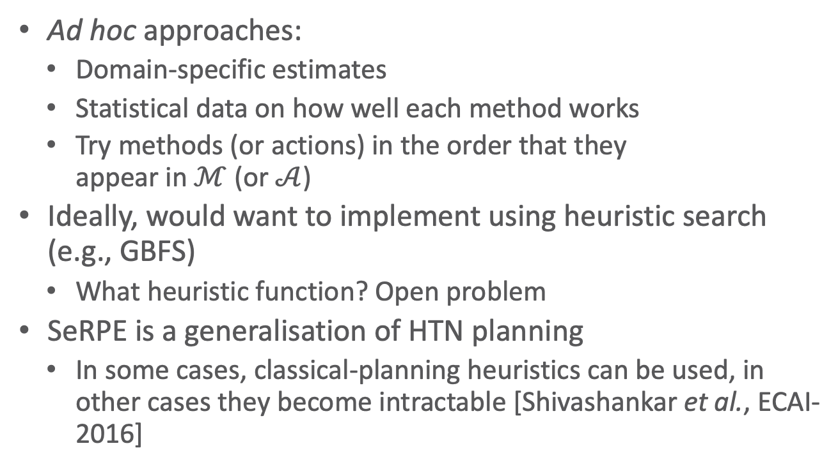
Heuristics For SeRPE
Ad hoc approaches:
  Domain-specific estimates
  Statistical data on how well each method works
  Try methods (or actions) in the order that they
  appear in $ℳ$ (or $𝒜$)
Ideally, would want to implement using heuristic search
(e.g., GBFS)
  What heuristic function? Open problem
SeRPE is a generalisation of HTN planning
  In some cases, classical-planning heuristics can be used, in other cases they become intractable [Shivashankar et al., ECAI-2016]
SeRPE(ℳ,𝒜,s,𝜏)
Candidates ← Instances(ℳ,𝜏,s)
if Candidates = ∅ then
return failure
nondeterministically choose m ∈ Candidates
return Progress-to-finish(ℳ,𝒜,s,𝜏,m)
Notes:
Acting: top-down, “left to right” (flying somewhere: get to airport, fly)
Planning: sometimes other order reasonable (flying somewhere: plan flight, then how to get to airport)

Slide 51
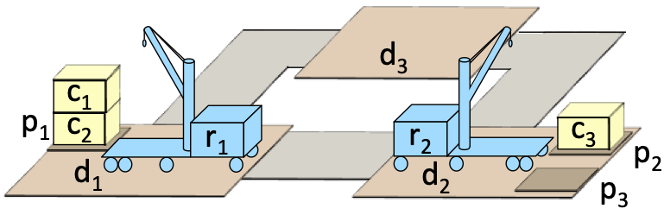
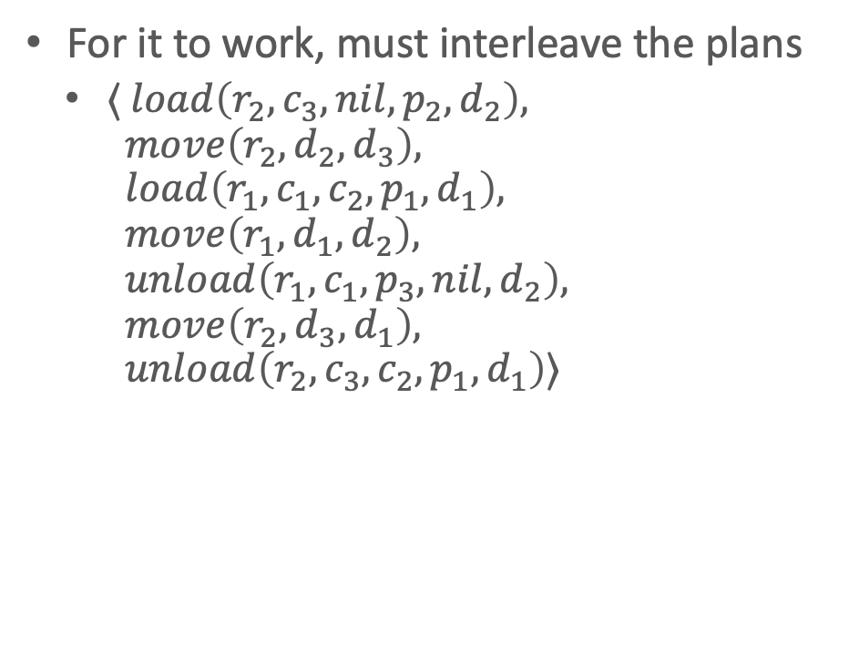
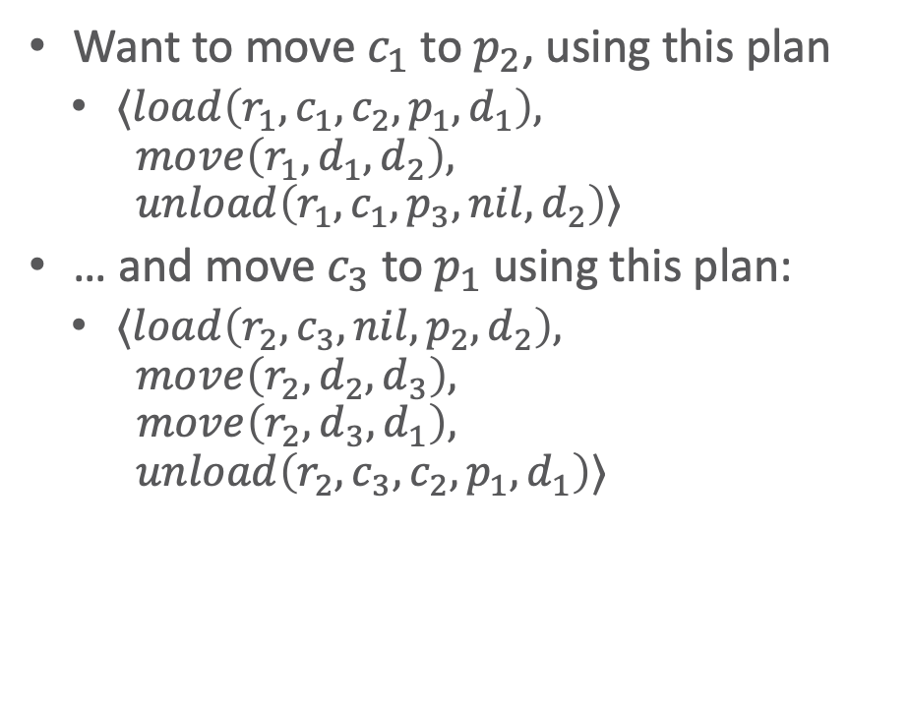
Interleaving
Want to move $c_{1}$ to $p_{2}$, using this plan
  $⟨load\left(r_{1},c_{1},c_{2},p_{1},d_{1}\right),$
  $move\left(r_{1},d_{1},d_{2}\right),$
  $unload\left(r_{1},c_{1},p_{3},nil,d_{2}\right)⟩$
… and move $c_{3}$ to $p_{1}$ using this plan:
  $⟨load\left(r_{2},c_{3},nil,p_{2},d_{2}\right),$
  $move\left(r_{2},d_{2},d_{3}\right),$
  $move\left(r_{2},d_{3},d_{1}\right),$
  $unload\left(r_{2},c_{3},c_{2},p_{1},d_{1}\right)⟩$
For it to work, must interleave the plans
  $⟨ load\left(r_{2},c_{3},nil,p_{2},d_{2}\right),$
  $move\left(r_{2},d_{2},d_{3}\right),$
  $load\left(r_{1},c_{1},c_{2},p_{1},d_{1}\right),$
  $move\left(r_{1},d_{1},d_{2}\right),$
  $unload\left(r_{1},c_{1},p_{3},nil,d_{2}\right),$
  $move\left(r_{2},d_{3},d_{1}\right),$
  $unload\left(r_{2},c_{3},c_{2},p_{1},d_{1}\right)⟩$

Slide 52
Interleaved Refinement Tree (IRT) Procedure
SeRPE does not allow the “concurrent” programming construct
Partial fix:
extend SeRPE to interleave plans for different tasks
Details:
Section 3.3.2

Slide 53
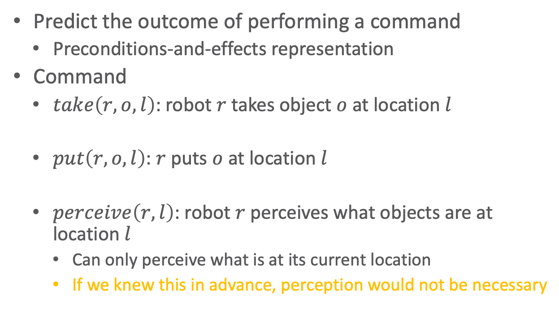
Descriptive Action Models
Predict the outcome of performing a command
  Preconditions-and-effects representation
Command
  $take\left(r,o,l\right)$: robot $r$ takes object $o$ at location $l$
  $put\left(r,o,l\right)$: $r$ puts $o$ at location $l$
  $perceive\left(r,l\right)$: robot $r$ perceives what objects are at location $l$
    Can only perceive what is at its current location
    If we knew this in advance, perception would not be necessary
Action model
take(r,o,l)
pre: cargo(r) = nil, loc(r) = l, loc(o) = l
eff: cargo(r) ← o, loc(o) ← r
put(r,o,l)
pre: loc(r) = l, loc(o) = r
eff: cargo(r) ← nil, loc(o) ← l
perceive(r,l)
?

Slide 54
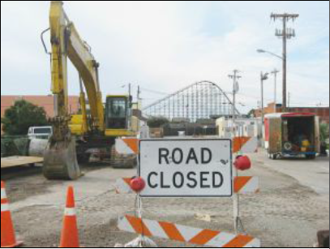
Limitation
Most environments are inherently nondeterministic
  Deterministic action models will not always make the right prediction
Why use them?
  Deterministic models ⇒ much simpler planning algorithms
    Use when errors are infrequent and do not have severe consequences
    Actor can fix the errors online
c
a
b
grasp(c)
c
a
b
a
b
c

Slide 55
Planning/Acting at Different Levels
Deterministic models may work better at some levels than others
May want
  RAE at some levels
  RAE+planner at some levels
  Planner at some levels
In some cases, might want the planner to reason about nondeterministic outcomes
  Later in lecture (Book: Ch. 5 + 6)
Ongoing research on extending refinement planning to handle nondeterminism
[Patra et al., AAAI-2019]
respond to user requests
…
bring o7 to loc2
…
go to
hallway
navigate
to loc1
fetch
o7
navigate
to loc2
deliver
o7
Planning Acting
…
…
…
…
move to door
open door
get out
close door
…
…
…
identify
type
of
door
move
close
to
knob
grasp
knob
turn
knob
maintain
move
back
ungrasp
pull
monitor
pull
monitor

Slide 56
Summary
Refinement planning (SeRPE)
  Plan by simulating RAE on a single external task/event/goal
  Deterministic actions
    OK if we are confident of outcome, can recover if things go wrong
  Interleaved plans (brief example)

Slide 57
Outline per the Book
3.1 Representation
  State variables, commands, refinement methods
  Example
3.2 Acting
  RAE (Refinement Acting Engine)
  Example
  Extensions
3.3 Planning
  Motivation and basic ideas
  Deterministic action models
  SeRPE (Sequential Refinement Planning Engine)
3.4 Using Planning in Acting
  Techniques
  Caveats

Slide 58
Acting and Refinement Planning
Hierarchical acting with refinement planning
  REAP: a RAE-like actor uses SeRPE-like planning at all levels
Non-hierarchical actor with refinement planning
  Refine-Lookahead, Refine-Lazy-Lookahead, Refine-Concurrent-Lookahead
    Essentially the same as
      Run-Lookahead, Run-Lazy-Lookahead, Run-Concurrent-Lookahead
  But they call SeRPE instead of a classical planner for acting out a given task
  Lookahead same as before
    Receding horizon, sampling, subgoaling
Notes:
REAP: seminar topic

Slide 59
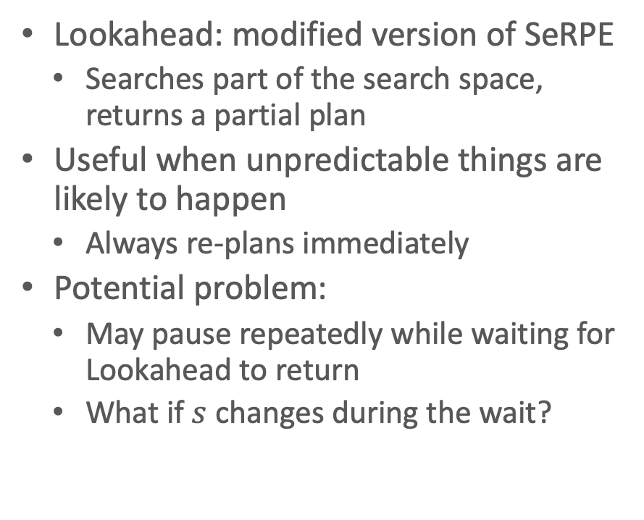
Using Planning in Acting
Lookahead: modified version of SeRPE
  Searches part of the search space, returns a partial plan
Useful when unpredictable things are likely to happen
  Always re-plans immediately
Potential problem:
  May pause repeatedly while waiting for Lookahead to return
  What if $s$ changes during the wait?
Inputs
M = {methods}
A = {action models}
𝜏 = task or goal
Refine-Lookahead(ℳ,𝒜,𝜏)
while (s ← abstraction of
observed state 𝜉) ⊭ 𝜏 do
𝜋 ← SeRPE-Lookahead(ℳ,𝒜,s,𝜏)
if 𝜋 = failure then
return failure
a ← pop-first-action(𝜋)
perform a
Planning stage
Acting stage

Slide 60
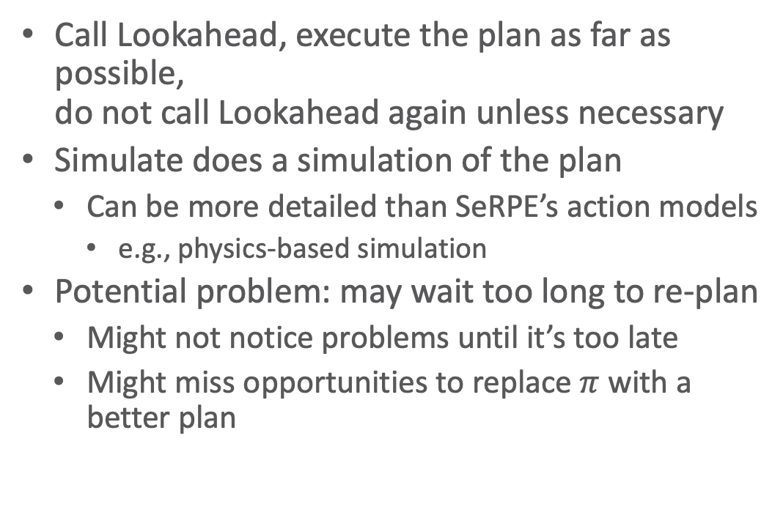
Using Planning in Acting
Call Lookahead, execute the plan as far as possible,
do not call Lookahead again unless necessary
Simulate does a simulation of the plan
  Can be more detailed than SeRPE’s action models
    e.g., physics-based simulation
Potential problem: may wait too long to re-plan
  Might not notice problems until it’s too late
  Might miss opportunities to replace $π$ with a better plan
Refine-Lazy-Lookahead(ℳ,𝒜,𝜏)
s ← abstraction of observed state 𝜉
while s ⊭ 𝜏 do
𝜋 ← SeRPE-Lookahead(ℳ,𝒜,s,𝜏)
if 𝜋 = failure then
return failure
while 𝜋 ≠ ⟨⟩ and s ⊭ 𝜏 and
Simulate(Σ,s,𝜏,𝜋) ≠ failure do
a ← pop-first-action(𝜋)
perform a
s ← abstraction of observed state 𝜉
Planning stage
Acting stage

Slide 61
Using Planning in Acting
Objective:
  Balance trade-offs between Refine-Lookahead and Refine-Lazy-Lookahead
  More up-to-date plans than Refine-Lazy-Lookahead, but without waiting for Lookahead to return
Refine-Concurrent-Lookahead(ℳ,𝒜,𝜏)
𝜋 ← ⟨⟩
s ← abstraction of observed state 𝜉
// threads 1 and 2 run concurrently
thread 1:
loop
𝜋 ← SeRPE-Lookahead(ℳ,𝒜,s,𝜏)
thread 2:
loop
if s ⊭ 𝜏 then
return success
else if 𝜋 = failure then
return failure
else if 𝜋 ≠ ⟨⟩ and s ⊭ 𝜏 and
Simulate(Σ,s,𝜏,𝜋) ≠ failure then
a ← pop-first-action(𝜋)
perform a
s ← abstraction of observed state 𝜉
Planning stage
Acting stage

Slide 62



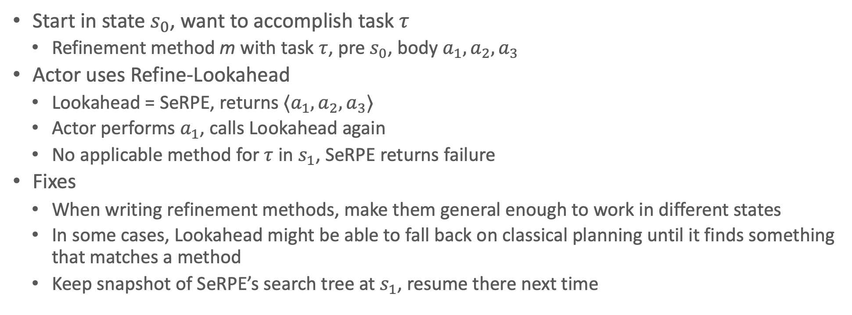




Caveats
Start in state $s_{0}$, want to accomplish task $τ$
  Refinement method m with task $τ$, pre $s_{0}$, body $a_{1}, a_{2}, a_{3}$
Actor uses Refine-Lookahead
  Lookahead = SeRPE, returns $⟨a_{1}, a_{2}, a_{3}⟩$
  Actor performs $a_{1}$, calls Lookahead again
  No applicable method for $τ$ in $s_{1}$, SeRPE returns failure
Fixes
  When writing refinement methods, make them general enough to work in different states
  In some cases, Lookahead might be able to fall back on classical planning until it finds something that matches a method
  Keep snapshot of SeRPE’s search tree at $s_{1}$, resume there next time
$$m$$
$$s_{0}$$
$$a_{1}$$
$$s_{1}$$
$$a_{2}$$
$$s_{2}$$
$$a_{3}$$

Slide 63
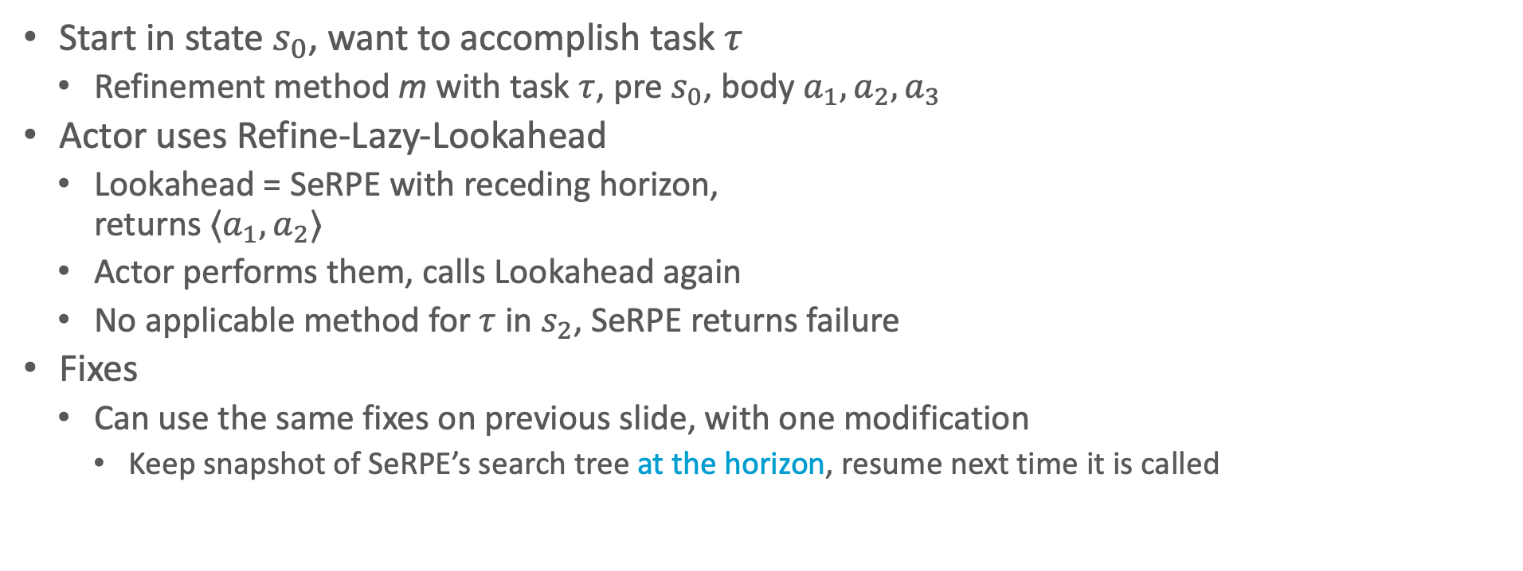
Caveats
horizon
Start in state $s_{0}$, want to accomplish task $τ$
  Refinement method m with task $τ$, pre $s_{0}$, body $a_{1}, a_{2}, a_{3}$
Actor uses Refine-Lazy-Lookahead
  Lookahead = SeRPE with receding horizon,
  returns $⟨a_{1}, a_{2}⟩$
  Actor performs them, calls Lookahead again
  No applicable method for $τ$ in $s_{2}$, SeRPE returns failure
Fixes
  Can use the same fixes on previous slide, with one modification
    Keep snapshot of SeRPE’s search tree at the horizon, resume next time it is called
$$m$$
$$s_{0}$$
$$a_{1}$$
$$s_{1}$$
$$a_{2}$$
$$s_{2}$$
$$a_{3}$$

Slide 64
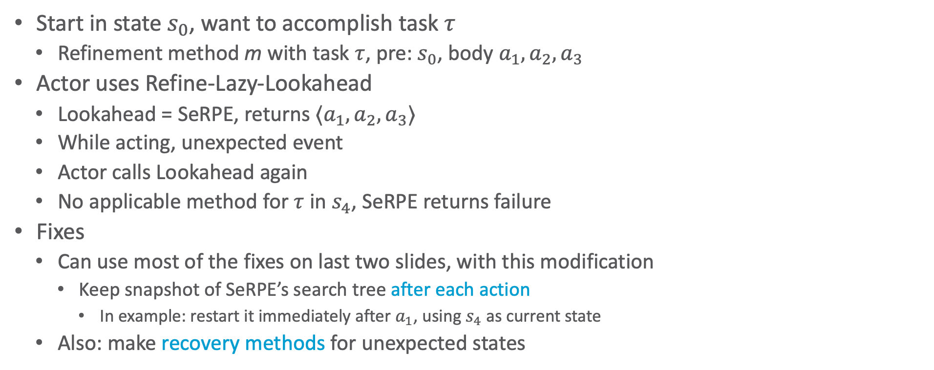



Caveats
Start in state $s_{0}$, want to accomplish task $τ$
  Refinement method m with task $τ$, pre: $s_{0}$, body $a_{1}, a_{2}, a_{3}$
Actor uses Refine-Lazy-Lookahead
  Lookahead = SeRPE, returns $⟨a_{1}, a_{2}, a_{3}⟩$
  While acting, unexpected event
  Actor calls Lookahead again
  No applicable method for $τ$ in $s_{4}$, SeRPE returns failure
Fixes
  Can use most of the fixes on last two slides, with this modification
    Keep snapshot of SeRPE’s search tree after each action
      In example: restart it immediately after $a_{1}$, using $s_{4}$ as current state
  Also: make recovery methods for unexpected states
$$m$$
$$s_{0}$$
$$a_{1}$$
$$s_{1}$$
$$a_{2}$$
$$s_{2}$$
$$a_{3}$$
$$s_{0}$$
$$a_{1}$$
$$s_{4}$$
Notes:
E.g., fix flat tire, get back on the road

Slide 65
Summary
Acting and planning
  Lookahead: search part of the search space, return a partial solution
  Refine-Lookahead, Refine-Lazy-Lookahead, Refine-Concurrent-Lookahead
    Like Run-Lookahead, Run-Lazy-Lookahead, Run-Concurrent-Lookahead, but call SeRPE
  Caveats
    Current state may not be what we expect
    Possible ways to handle that

Slide 66
Outline per the Book
3.1 Representation
  State variables, commands, refinement methods
  Example
3.2 Acting
  RAE (Refinement Acting Engine)
  Example
  Extensions
3.3 Planning
  Motivation and basic ideas
  Deterministic action models
  SeRPE (Sequential Refinement Planning Engine)
3.4 Using Planning in Acting
  Techniques
  Caveats
⟹ Next: Planning and Acting with Temporal Models

