Slide 1








Human Pose Recovery and Behavior Analysis Group
Probability-based Dynamic Time Warping for Gesture Recognition on RGB-D data
Miguel Ángel Bautista^{1,2}
Antonio Hernández-Vela^{1,2}
Xavier Perez-Sala^{2,3}
Victor Ponce Lopez^{1,2}
Xavier Baro^{2,4}
Oriol Pujol^{1,2}
Cecilio Angulo³
Sergio Escalera^{1,2}
¹Dept. Applied Mathematics and Analysis, Universitat de Barcelona
²Computer Vision Center, Universitat Autónoma de Barcelona
³CETpD, Universitat Politècnica de Catalunya
⁴EIMT, Universitat Oberta de Catalunya
All rights reserved HuBPA©
Notes:
Konichiwa or Combanwa everybody!!
Welcome to this presentation…titled…
Work of many people in Barcelona…many of them present in here now

Slide 2

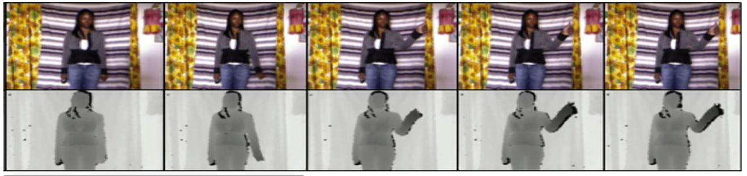
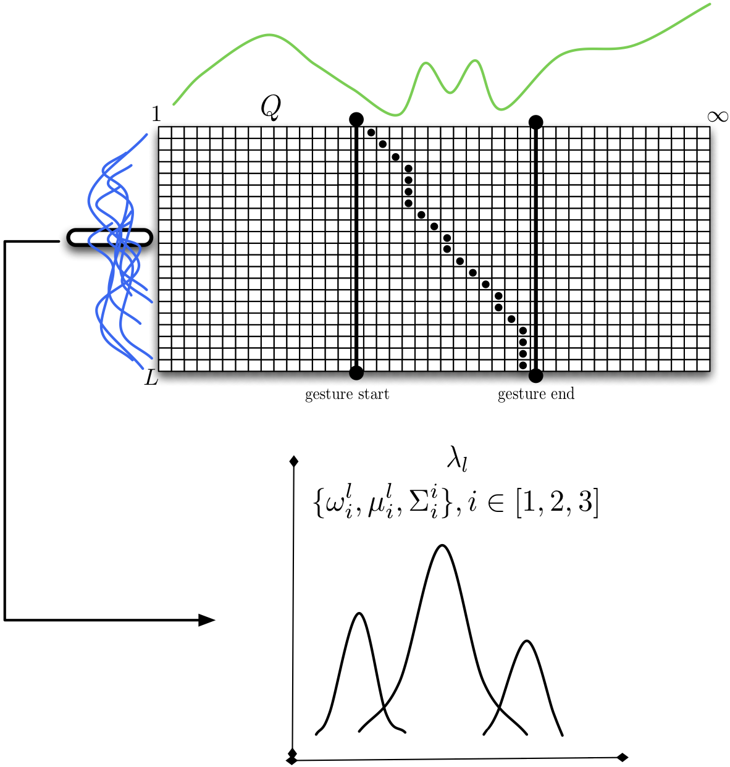

Human Pose Recovery and Behavior Analysis
Group
Probability-based DTW for gesture recognition on RGB-D data
Outline
Introduction
Methodology
Results
Conclusion
All rights reserved HuBPA©
Notes:
Brief outline…as usual 4 points.
I will introduce the problem of gesture recognition on infinite video sequences
The I will explain how our proposal is able to deal with intra-class variability of a gesture category. By making use of RGB-D multimodal data .
Finally I will show our experimental results on a real world problem
And I will show the conclusions.

Slide 3
Human Pose Recovery and Behavior Analysis
Group
Multimodal Gesture Recognition on
RGB-D data
Problem:
  Continuous Gesture Recognition in video sequences.
  Multimodal data, RGB+D.
Approaches:
  Probabilistic Graphical Models.
  Dynamic Time Warping.
All rights reserved HuBPA©
Notes:
Brief outline…as usual 4 points.
I will introduce the problem of multimodal gesture recognition on RGBD Data
The I will explain how our proposal is able to deal with intra-class variability of a gesture category. By making use of multimodal data.
Finally I will show our experimental results on a real world problem
And I will show the conclusions.

Slide 4
Human Pose Recovery and Behavior Analysis
Group
Dynamic Time Warping
Introduction
Methodology
Results
Conclusion
∞
Gesture start
Gesture end
All rights reserved HuBPA©
Notes:
Now, I’m assuming that most of the audience knows that DTW is an algorithm for sequence alignment.
So, for example let us show this two signals.
DTW will find an alignment or a point to point assignation from the blue signal (input) to the green signal (pattern signal)
This alignment compresses or stretches the input signal obtaining a deformation that fits the pattern signal.
You see, this alignment is computed using Dynamic Programming so given the previous signals a DP matrix will be constructed, in which each position will contain the cumulative association cost, which is usually a distance metric.
To obtain the alignment the minimum cost backward path is reconstructed obtaining the point to point assignation.
However, in real world problems (concretely in gesture recognition) DTW is used in infinite steaming sequences (video sequences) in which a pattern has to be detected. In this context the approach is very similar, with the exception of a cost threshold that has to be manually set in order to reconstruct the backward path.
The detection is performed by calculating the start and end point of the input signal in the infinite streaming sequence.

Slide 5
Human Pose Recovery and Behavior Analysis
Group
Probability-based DTW for gesture recognition on RGB-D data
Introduction
Methodology
Results
Conclusion
Our goal:
  Improve the detection by encoding the variability of a certain gesture category using RGB-D data.
Our proposal:
  Use DTW to align gesture samples in order to deal with temporal deformations.
  Use Gaussian Mixture Models to deal with pose deformations.
  Include a soft-distance based on posterior probabilities in the DTW algorithm.
All rights reserved HuBPA©
Notes:
However, one may argue that for gesture detection an alignment between an streaming sequence and a signal is not enough, since just one sample of a gesture is not able to encode the whole variability of the concrete gesture class.
So, our goal is to use many samples of the same gesture class in order to encode the variability and improve the detection rate.
We propose a method that is able to deal with temporal deformation on gesture samples by using DTW. Furthermore, by using GMM the method is able to deal with pose deformations and this is included in the DTW framework by using a soft-distance based on GMM posterior probabilities.

Slide 6
Human Pose Recovery and Behavior Analysis
Group
BoVDW for Gesture Recognition
Introduction
Methodology
Results
Conclusion
Gesture samples alignment
GMM learning
Soft-Distance based on GMM
DTW
Training
Testing
All rights reserved HuBPA©
Notes:
Now, this is the main pipeline of the proposed approach :
In the training step we have the gesture samples alignmente and the GMM learning
And in the testing step we show the computation of the soft-distance based on GMM and finally how it is included in the DTW algorithm

Slide 7
Human Pose Recovery and Behavior Analysis
Group
Gesture samples alignment
Introduction
Methodology
Results
Conclusion
Gesture samples alignment
GMM learning
Soft-Distance based on GMM
DTW
Different samples are used to model the pattern gesture.
To deal with temporal deformations all samples are aligned with the mean length sample using classic DTW.
Training set
Mean length sample
DTW
All rights reserved HuBPA©
Notes:
So , first step : Gesture sample alignment.
Let’s consider this set of blue signals that belong to the same gesture category.
To avoid temporal deformations, all signals are aligned with the mean size sample using DTW (with Euclidean distance).
In the end, we obtain a set of signals with the same length that belong to a certain gesture category, this will be out training set.

Slide 8
Human Pose Recovery and Behavior Analysis
Group
GMM learning
Introduction
Methodology
Results
Conclusion
Gesture samples alignment
GMM learning
Soft-Distance based on GMM
DTW
When the gesture samples are aligned we use a Gaussian Mixture Model to learn each set of elements overall sequences.
Training set
Frame 1
Frame N
All rights reserved HuBPA©
Notes:
Now, once our training set is defined, we want to avoid pose deformations by using GMM learning. Taking into account that all samples have now the same length (same number of elements).
We use GMM to learn each set of i-th elements over all sequences, in this example the set of 5th elements is modeled with a GMM with 3 components.

Slide 9
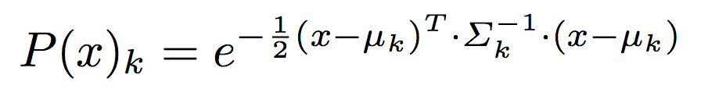
Human Pose Recovery and Behavior Analysis
Group
Soft-Distance based on GMM posterior probability
Introduction
Methodology
Results
Conclusion
Gesture samples alignment
GMM learning
Soft-Distance based on GMM
DTW
All rights reserved HuBPA©
Notes:
Now, in the testing step: for every element X in the infinite streaming sequence, we obtain its posterior probability for the GMM lambda that modeled the correspondent set of elements in the training set.
Once the posterior probabilities are obtained we can obtain the probability of of this element X on the whole GMM by weighting the probabilitiy of each component in the GMM with its mixing proportion alpha.
And then we use the global probability to define a soft distance in this way.

Slide 10
Human Pose Recovery and Behavior Analysis
Group
DTW
Introduction
Methodology
Results
Conclusion
Gesture samples alignment
GMM learning
Soft-Distance based on GMM
DTW
All rights reserved HuBPA©
Notes:
Finally the soft distance is included in the DTW framework and the gesture detection is computed with the usual start-end approach.

Slide 11
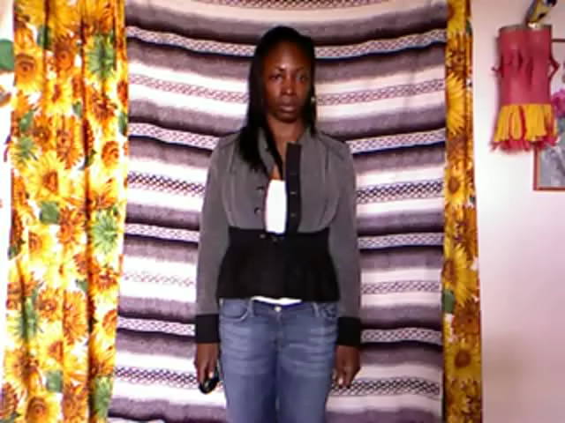
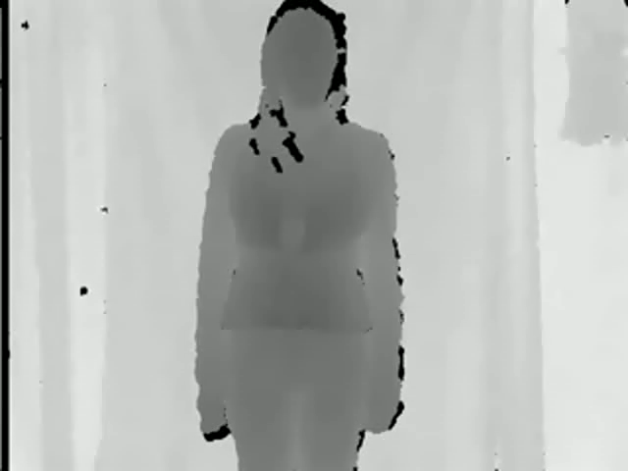
Human Pose Recovery and Behavior Analysis
Group
Experimental Settings
Introduction
Methodology
Results
Conclusion
Data:
  ChaLearn Dataset (CVPR2012), in which, each video sequence shows an actor performing a set of gestures discriminated by an Idle gesture performed in between (more than 940 sequences).
  Our goal is to detect the Idle gesture (more than 1000 samples available).
  We defined a 10×10 grid approach to extract HOG+HOF feature descriptors per cell.
  We use 900 samples of the gesture category in a ten-fold validation procedure.
Methods:
  Classic DTW with Euclidean distance.
  Hidden Markov Model.
  Probability-based DTW.
Evaluation:
  We obtain the overlapping metric (frame wise) and the accuracy metric of the number of gestures detected in each video sequences.
All rights reserved HuBPA©
Notes:
In our experiments we will use the Chalearn dataset, which is composed of video sequences in which an actor is portrayed performing a set of different gestures always with an idle gesture inbetween.
Accuracy of detected gestures, a gesture is detected if 60% of overlapping is found.

Slide 12
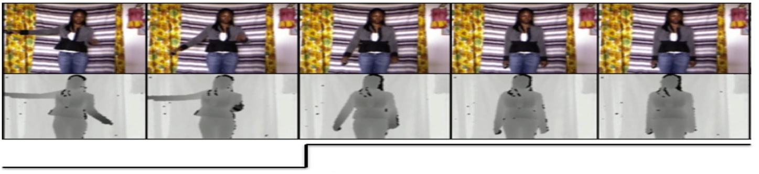
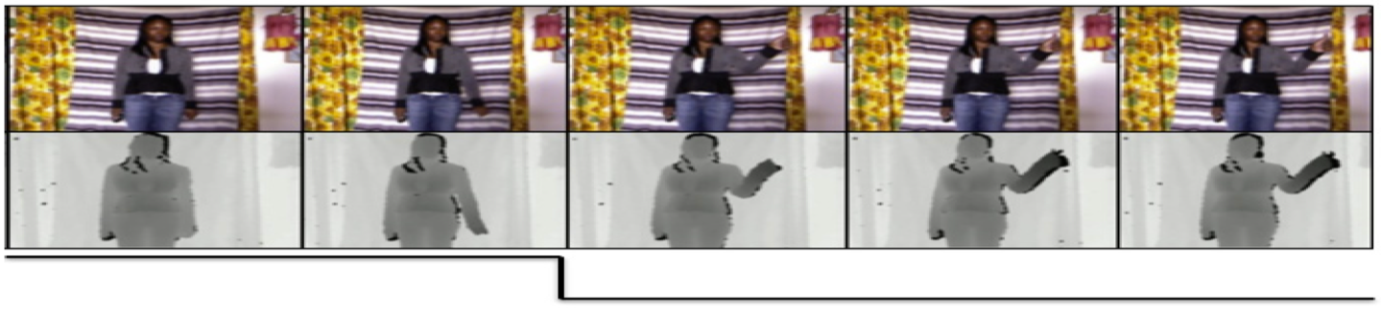
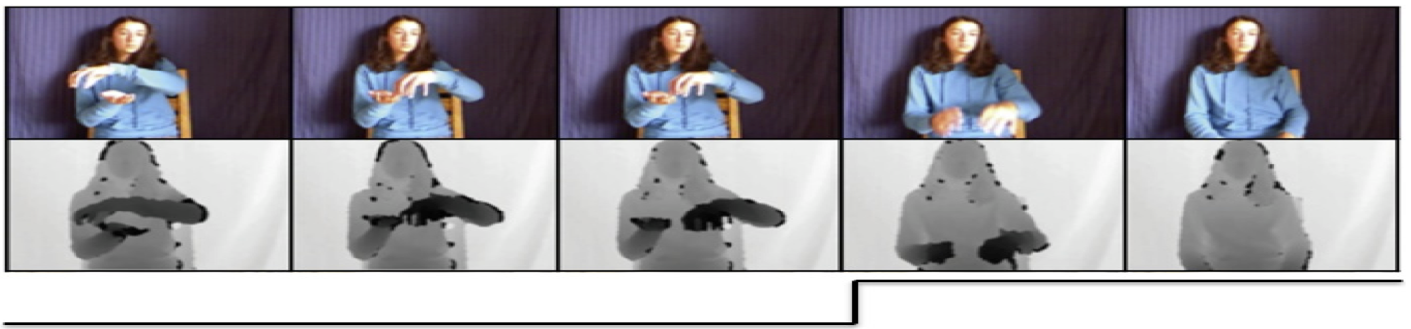
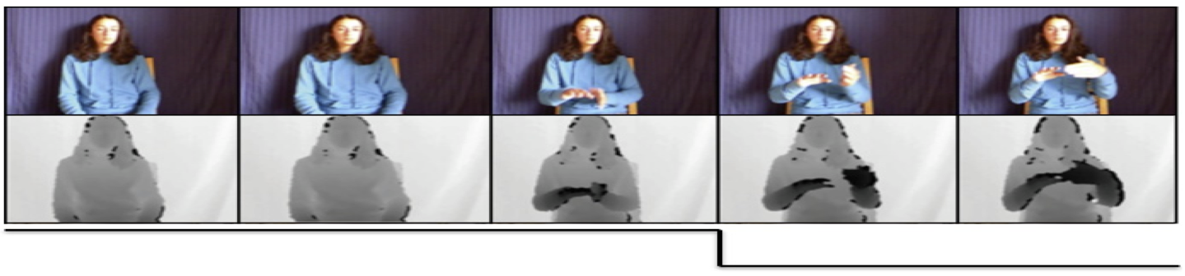
Human Pose Recovery and Behavior Analysis
Group
Qualitative results
Introduction
Methodology
Results
Conclusion
Idle gesture detection for two video sequences in the ChaLearn Dataset.
All rights reserved HuBPA©
Notes:
In this slide we show detections for two different sequences the we show for each sequence the RGB and Depth images and the detection flag. I should point that the two actors are showing different poses full body in the first one and only upper body in the second. However, the proposed method is able to detect the idle gesture by encoding the possible deformations both in time and pose.

Slide 13
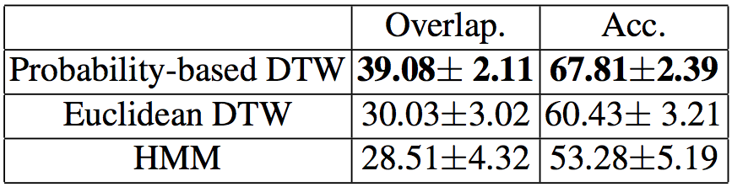
Human Pose Recovery and Behavior Analysis
Group
Quantitative results
Introduction
Methodology
Results
Conclusion
Results show how the new approach outperforms classic DTW and HMM by nearly 10% of overlapping.
When analyzing the accuracy, it can be seen that the new approach easily detects more Idle gestures than the classical approaches.
Subtle differences found between Euclidean DTW and HMM.
All rights reserved HuBPA©
Notes:
We show quantitative results for our proposal, the usual Euclidean DTW taking the mean length gesture and HMM trained with 3 states and (Baum-Welch for training and Viterbi algorithm for detection). You can see how our approach outperforms both methods by over 10% in the overlapping metric and even more when it comes to the accuracy in the number of detected gestures.

Slide 14
Human Pose Recovery and Behavior Analysis
Human Pose Recovery and Behavior Analysis
Group
Conclusions & Future work
Introduction
Methodology
Results
Conclusion
We proposed a probability-based DTW for gesture recognition.
The pattern model is learned from several samples of the same gesture category using multimodal RGBD data.
Different sequences were used to build a Gaussian-based probabilistic model of the gesture whose possible deformations are implicitly encoded.
A soft-distance based on the posterior probability of the GMM was defined.
The proposal is able to deal with multiple deformations in data, showing performance improvements compared to the classical DTW and HMM approaches.
All rights reserved HuBPA©
Notes:
We proposed a probability based DTW for gesture recognition
The pattern model is learned from several instances
Those samples where used to build a model that is able to capture intra-class variability
This is included in the general framework of DTW.
By modeling the intra-class variability the proposal obtains performance improvements compared with classical DTW and HMM

Slide 15
Human Pose Recovery and Behavior Analysis Group
Probability-based dynamic time warping for gesture recognition on RGB-D data
Thank you!
Miguel Ángel Bautista^{1,2}
Antonio Hernández-Vela^{1,2}
Xavier Perez-Sala^{2,3}
Victor Ponce Lopez^{1,2}
Xavier Baro^{2,4}
Oriol Pujol^{1,2}
Cecilio Angulo³
Sergio Escalera^{1,2}
¹Dept. Applied Mathematics and Analysis, Universitat de Barcelona
²Computer Vision Center, Universitat Autónoma de Barcelona
³CETpD, Universitat Politècnica de Catalunya
⁴EIMT, Universitat Oberta de Catalunya
All rights reserved HuBPA©

